Slide 1












Wardiere Inc.
Home
Service
About Us
Contact
Search . . . .
FULL-STACK SAAS
APPLICATION

Slide 2

Wardiere Inc.
Home
Service
About Us
Contact
Search . . . .
ABOUT ARTIFICIAL INTELLIGENCE
Artificial Intelligence (AI) is a field of computer science focused on creating machines and systems capable of performing tasks that normally require human intelligence. These tasks include things like learning, reasoning, problem-solving, understanding language, recognizing patterns, and making decisions.
In simple terms:
AI enables computers and machines to think, learn, and act—at least in limited ways—like humans.
Two Main Types:
Narrow AI: Systems designed for specific tasks (e.g., voice assistants, recommendation systems).
General AI: A theoretical form of AI capable of performing any intellectual task a human can do (still not achieved).

Slide 3
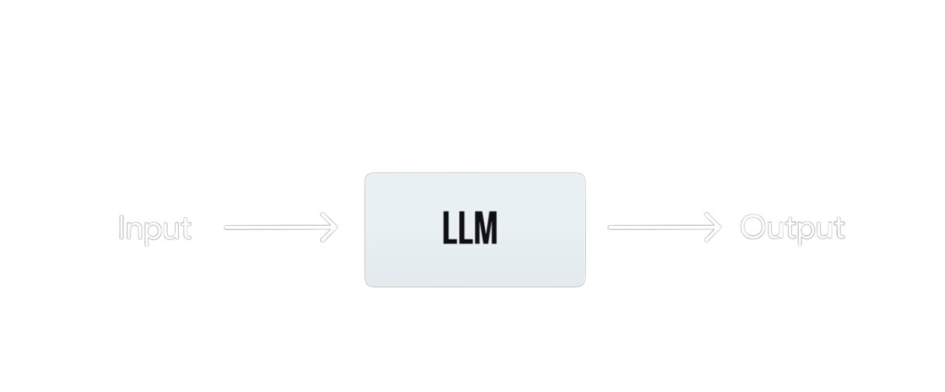

Slide 4
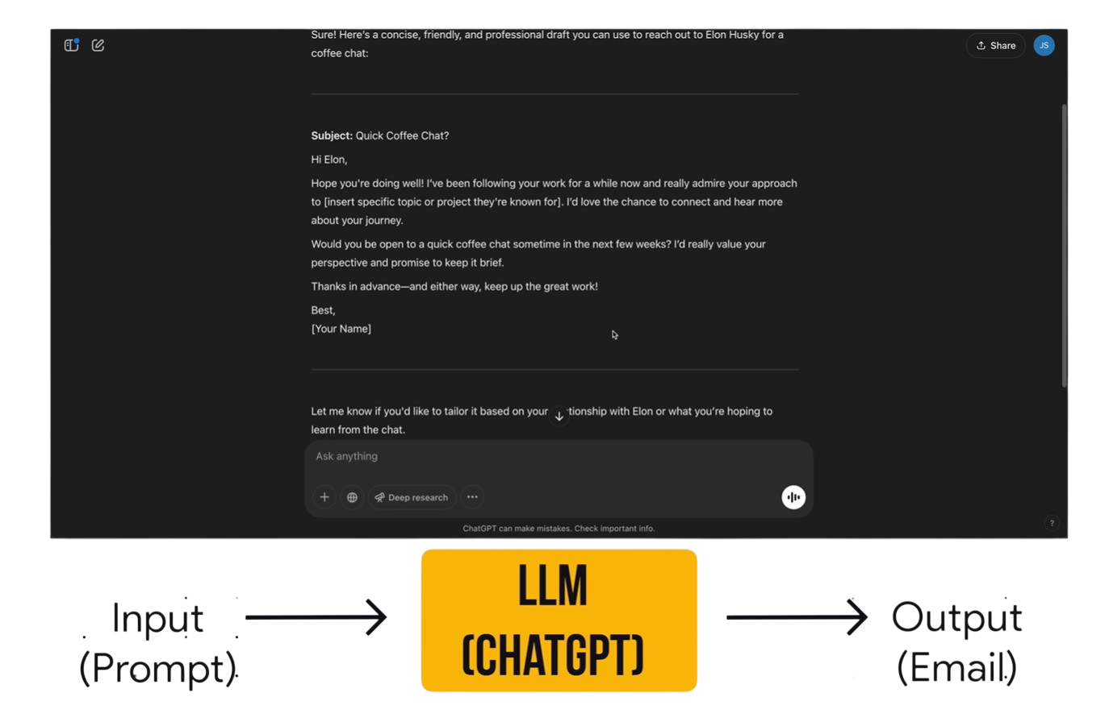

Slide 5
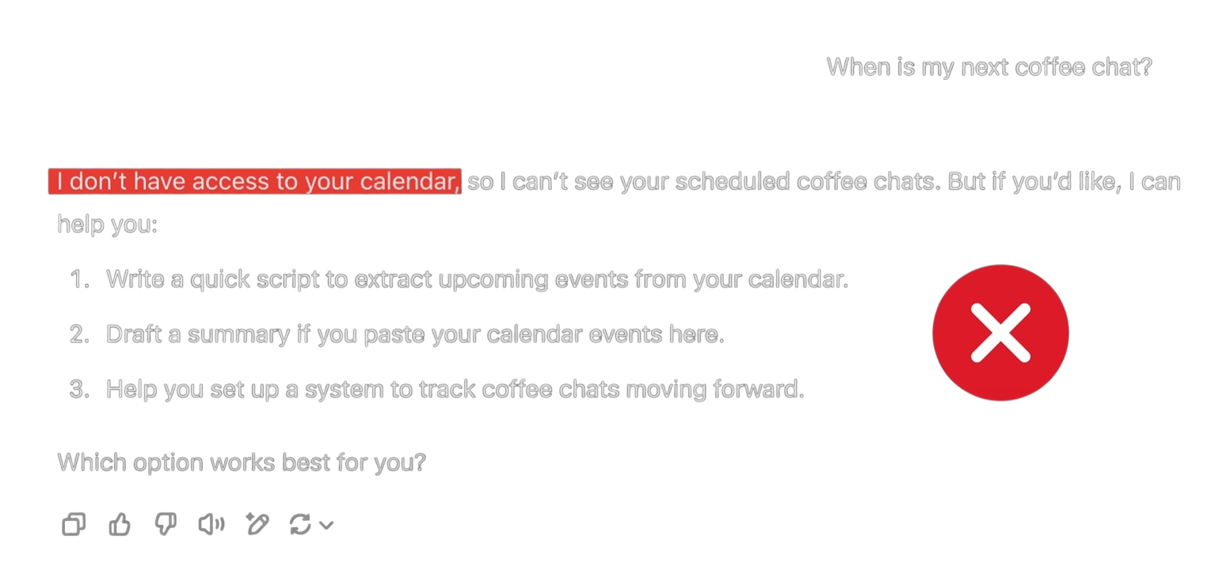

Slide 6
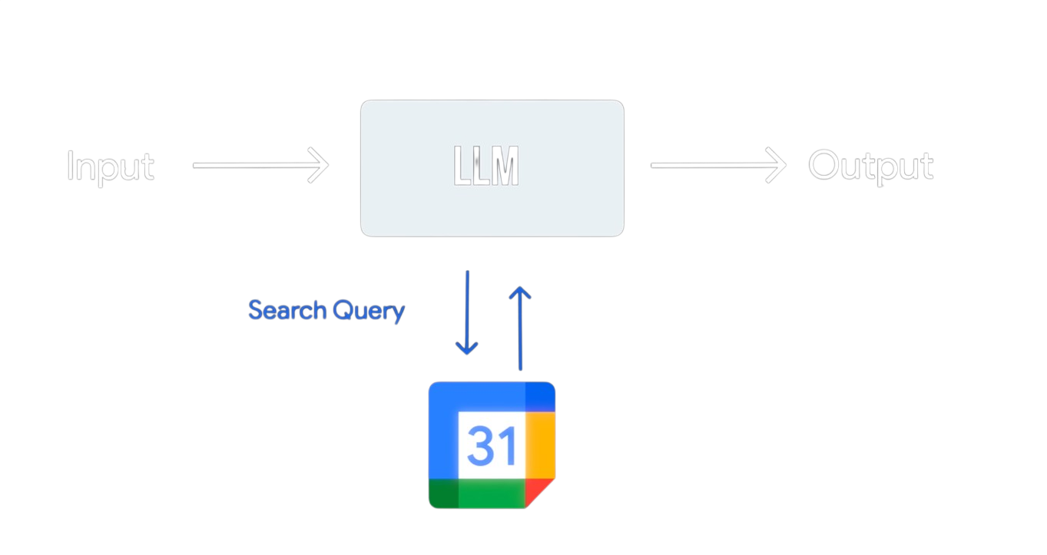

Slide 7
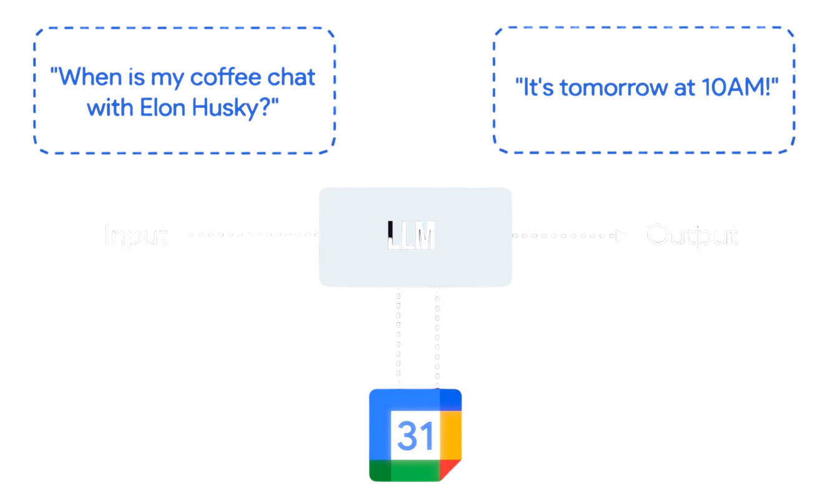

Slide 8
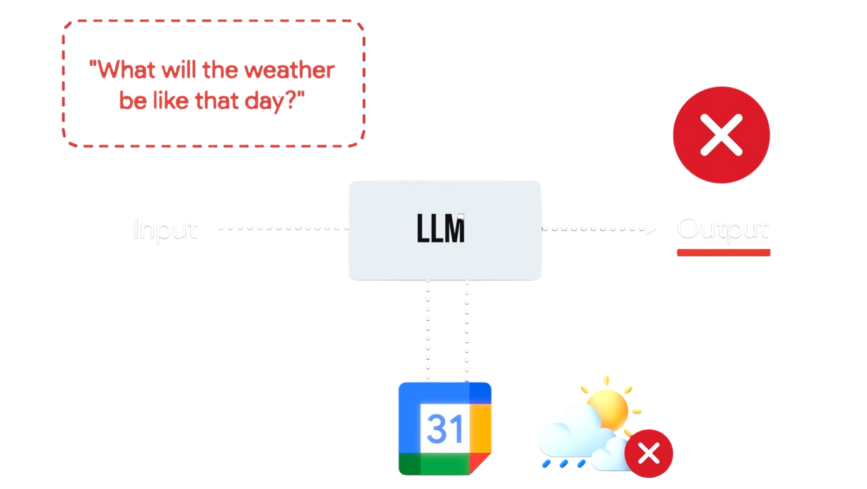

Slide 9
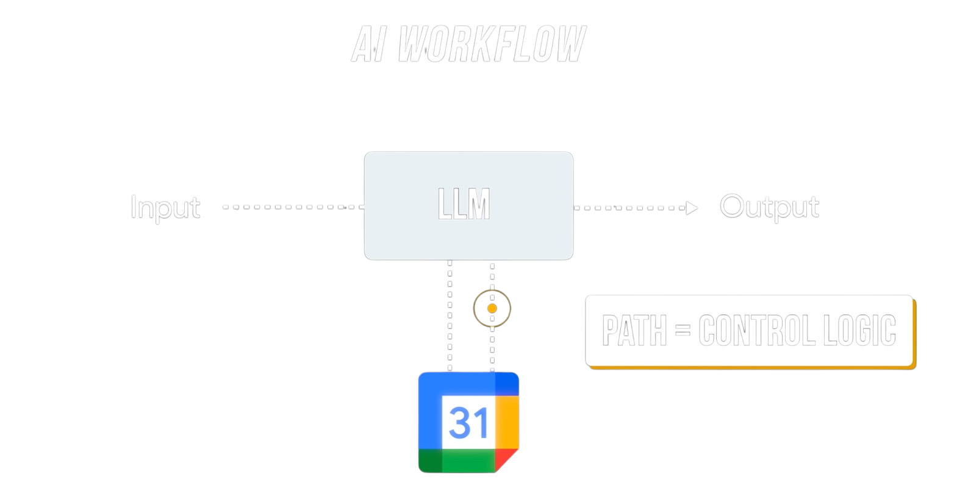

Slide 10
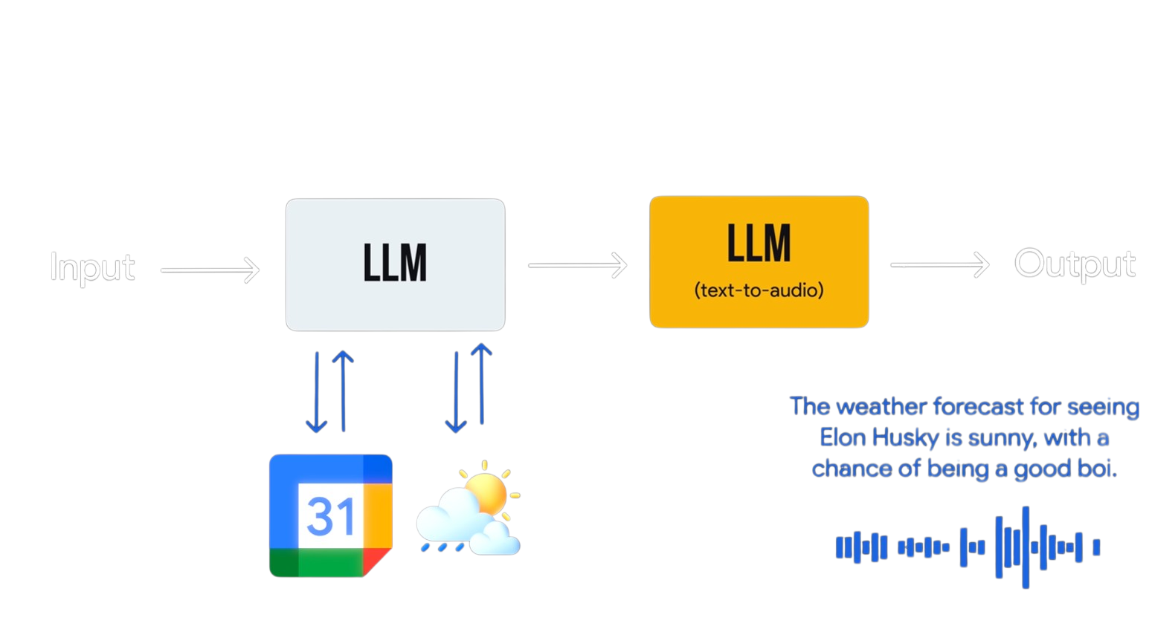

Slide 11
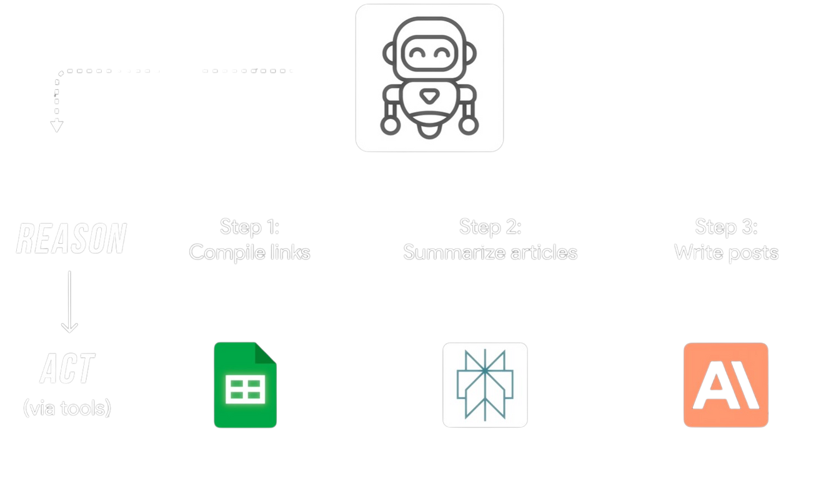

Slide 12
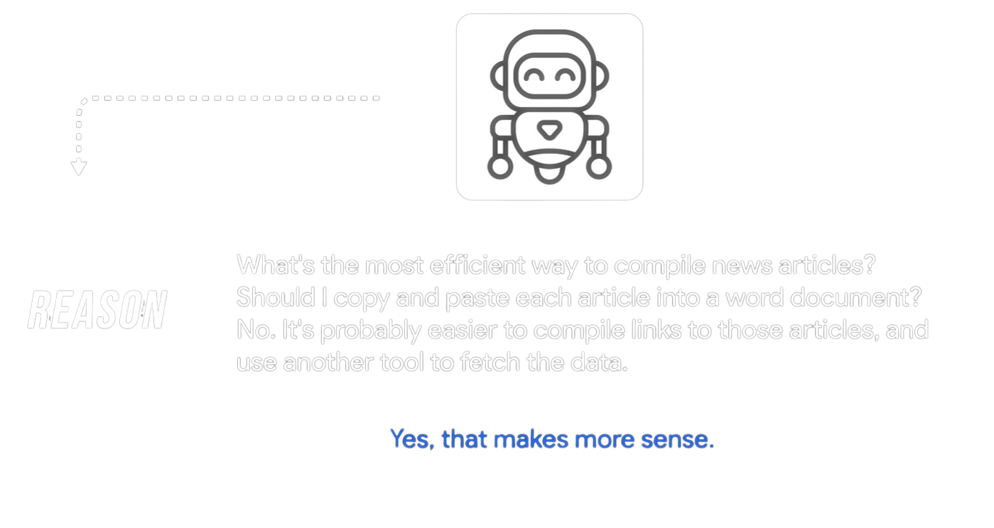

Slide 13
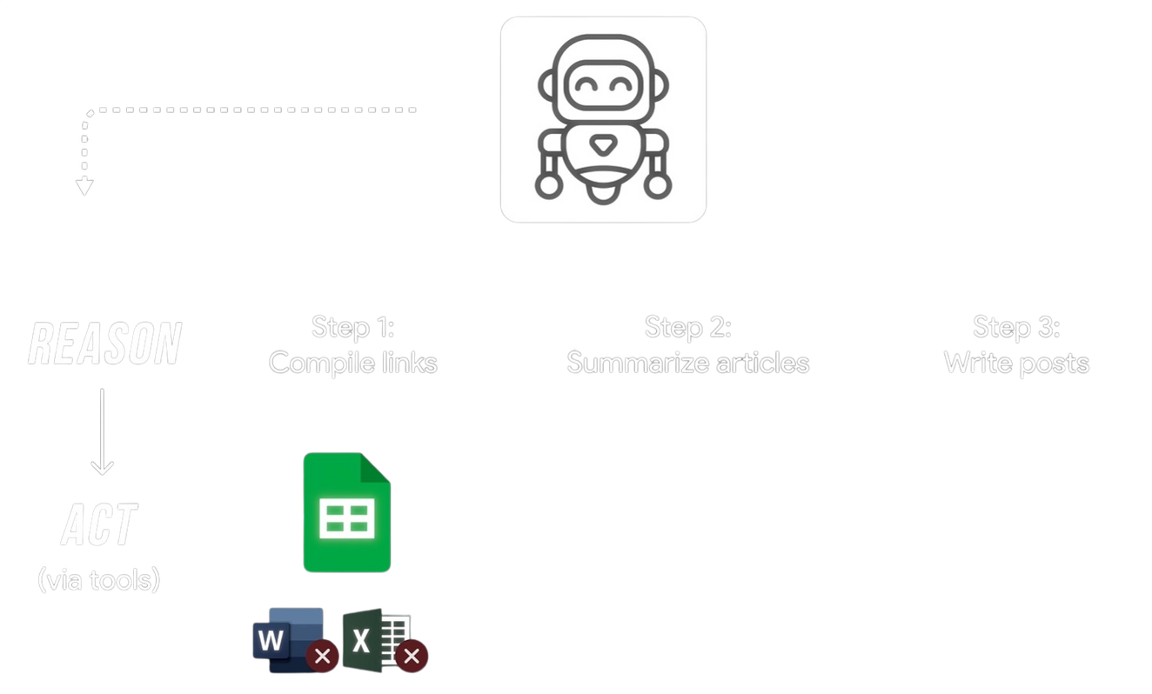

Slide 14
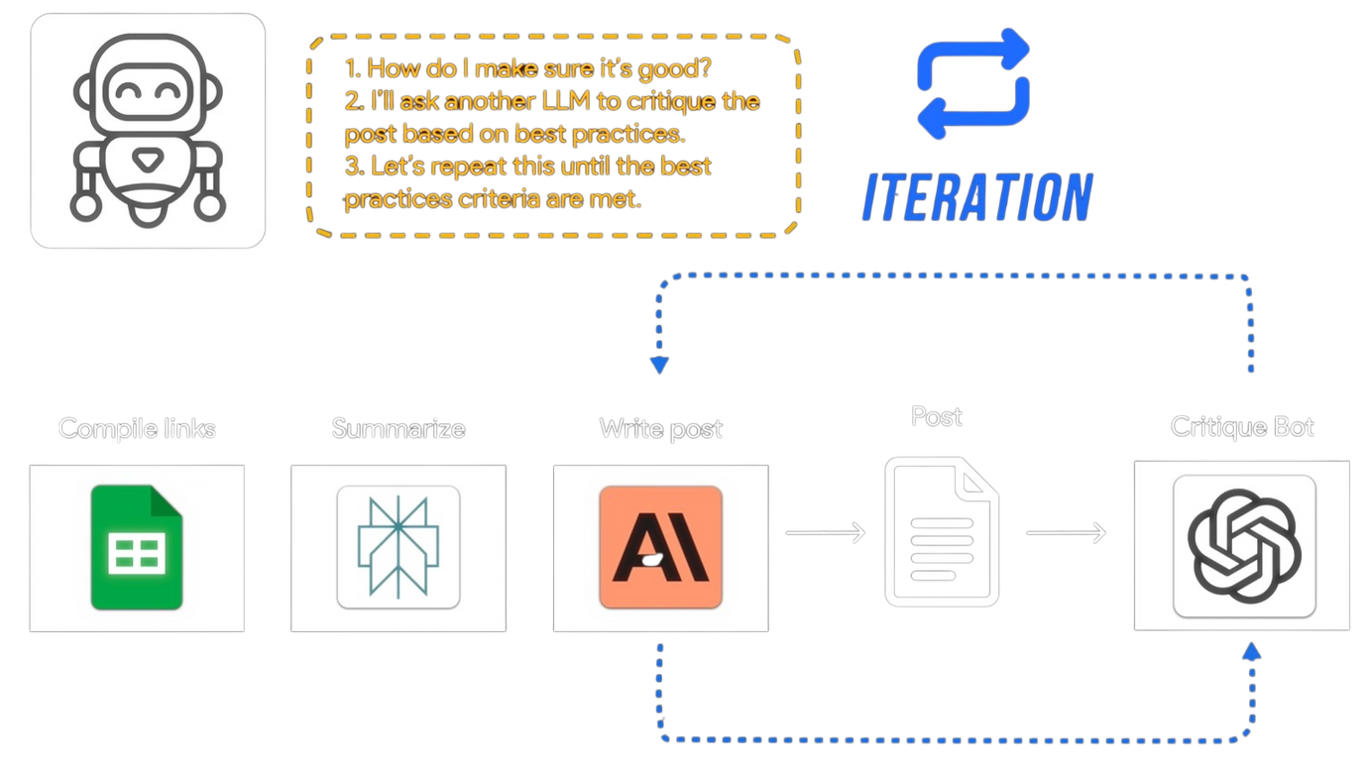

Slide 15
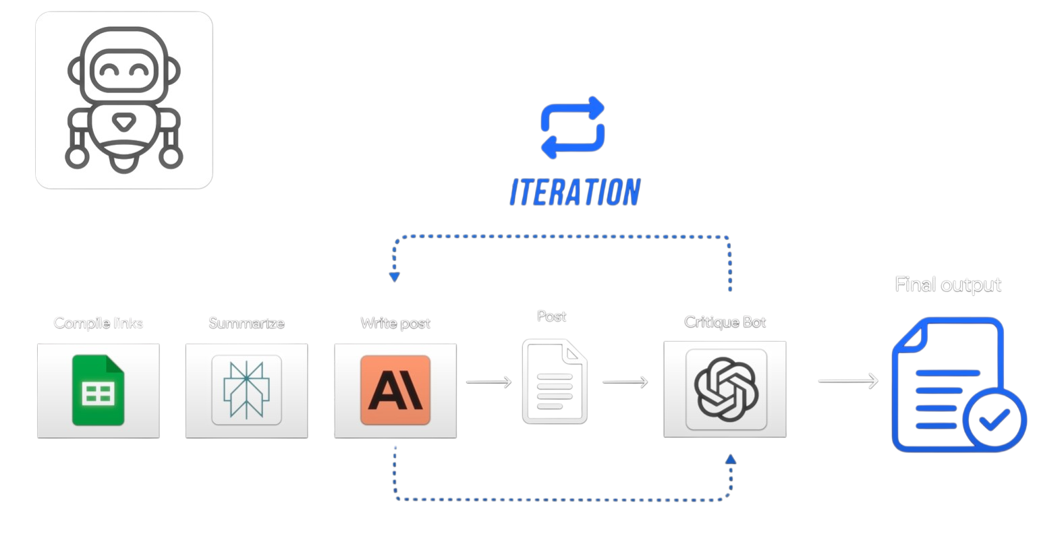

Slide 16
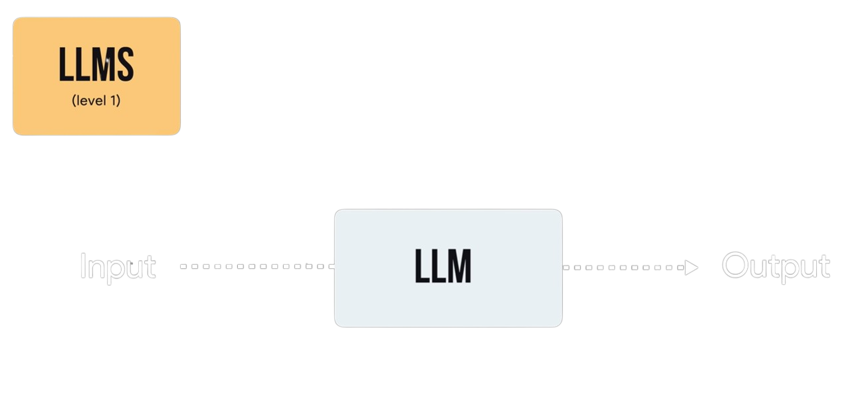

Slide 17
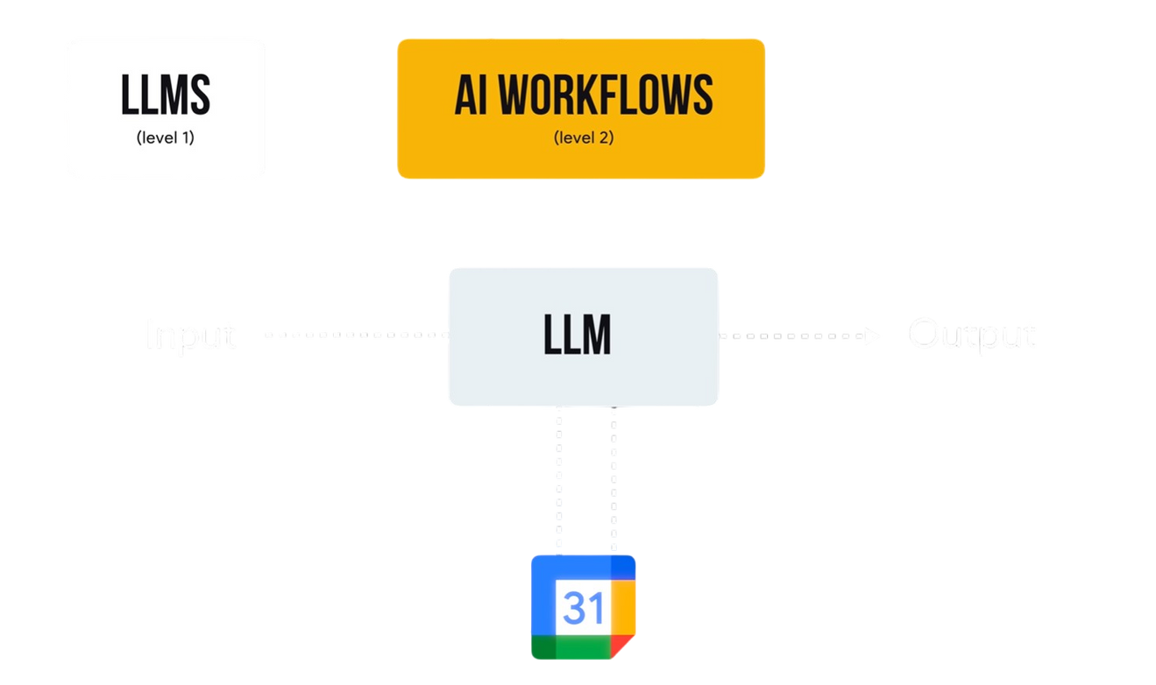

Slide 18
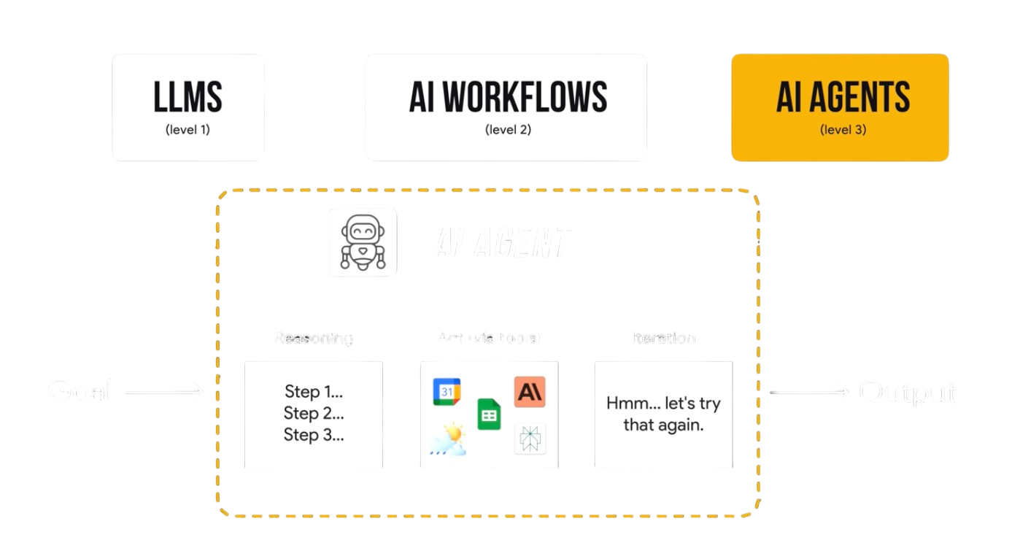

Slide 19

Wardiere Inc.
Home
Service
About Us
Contact
Search . . . .
QUICKAI
QuickAI is a cloud-based SaaS platform that simplifies content creation, image editing, and resume enhancement using powerful AI tools—accessible to anyone, without coding.
It combines AI-powered text generation, image manipulation, and productivity features into a single unified dashboard, helping creators and businesses automate their work effortlessly.

Slide 20

Wardiere Inc.
Home
Service
About Us
Contact
Search . . . .
FEATURES
01
AI Article Writing: Instantly generate full-length, professional articles using AI.
02
Blog Title Generator: Get creative, SEO-friendly titles with a single click.
03
AI Image Generation: Create unique images from text prompts using AI models.

Slide 21
Wardiere Inc.
Home
Service
About Us
Contact
Search . . . .
FEATURES
04
Object Remover: Erase unwanted elements from photos easily.
05
Resume Reviewer: Improve resumes with AI feedback for better job applications.
06
Community Access: Connect and collaborate with other users inside QuickAI.

Slide 22
Wardiere Inc.
Home
Service
About Us
Contact
Search . . . .
ABOUT TECHNOLOGY
Frontend: React, Vite, TailwindCSS
01
Backend: Node.js/Express:, PostgreSQL (Neon), Gemini, Clipdrop, Cloudinary, Clerk
02
DevOPS: Docker, vercel
03

Slide 23
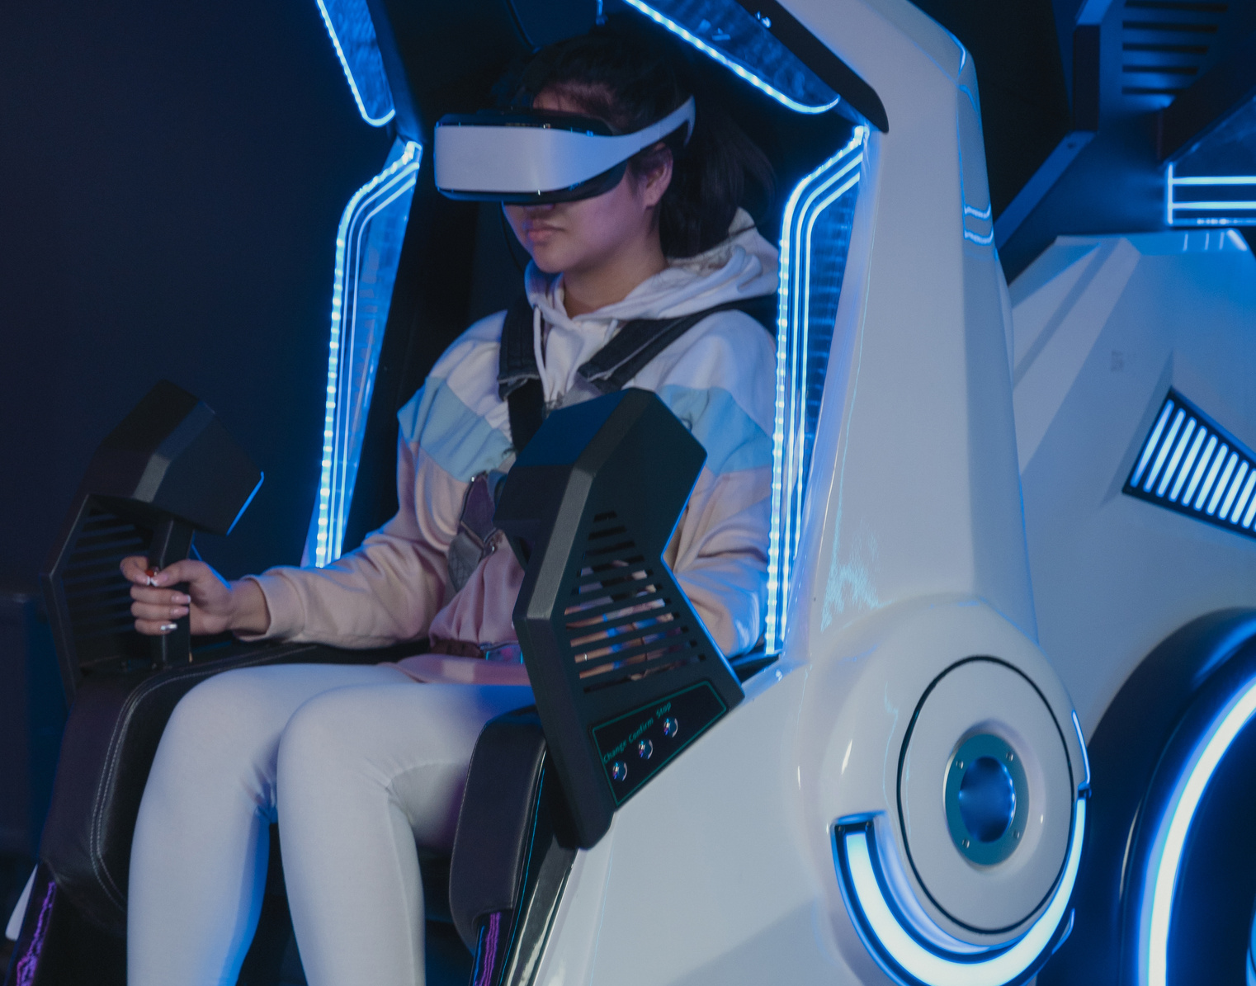

Wardiere Inc.
Home
Service
About Us
Contact
Search . . . .
OUR PORTFOLIO
Our dashboard offers real-time updates on your creations and usage, all accessible from one central, user-friendly interface. Its modern design ensures seamless navigation and an enjoyable user experience.

Slide 24


Wardiere Inc.
Home
Service
About Us
Contact
Search . . . .
OUR MISSION
01
Unified AI Platform: Seamlessly combines text, image, and productivity tools.
02
Cloud-Based Accessibility: Create and manage content from anywhere, anytime.
03
User-Friendly Interface: Modern design requiring no technical expertise.
04
Secure & Scalable: Robust architecture built for future growth and reliability.

Slide 25
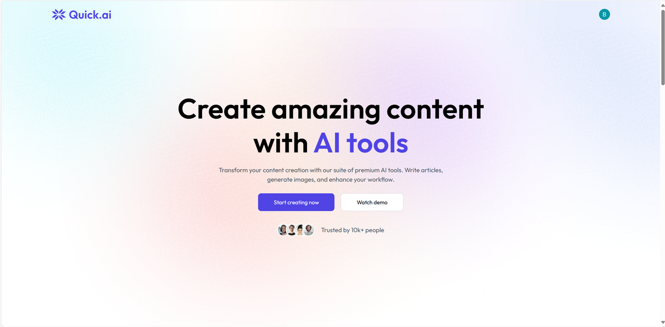
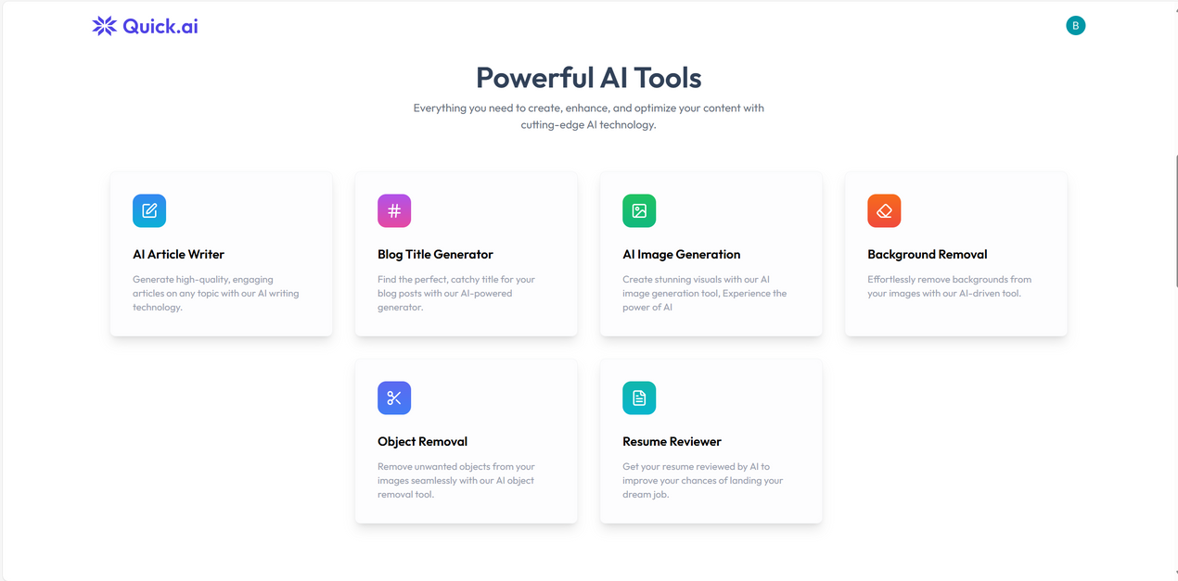
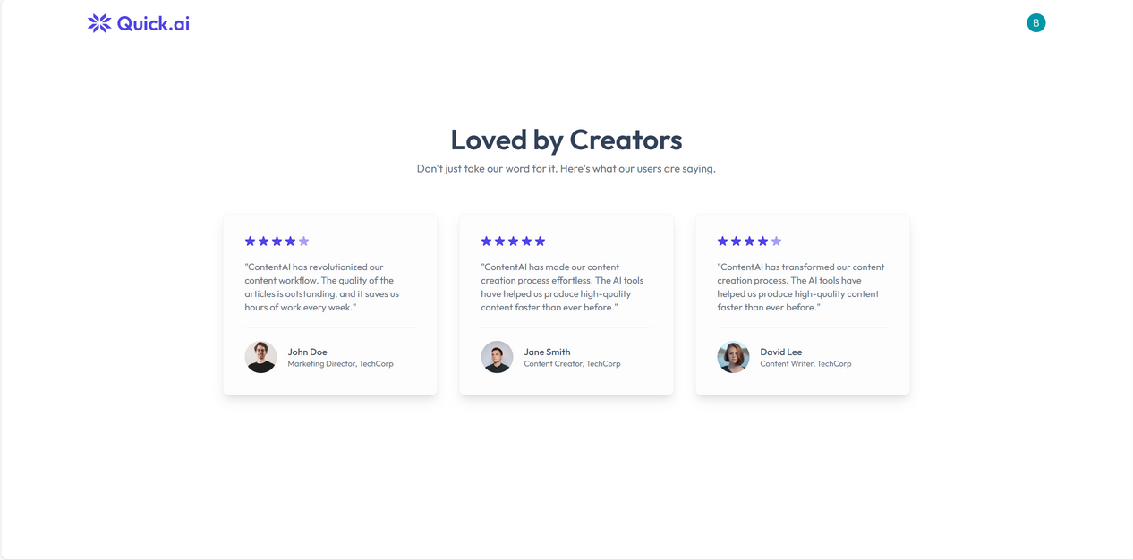
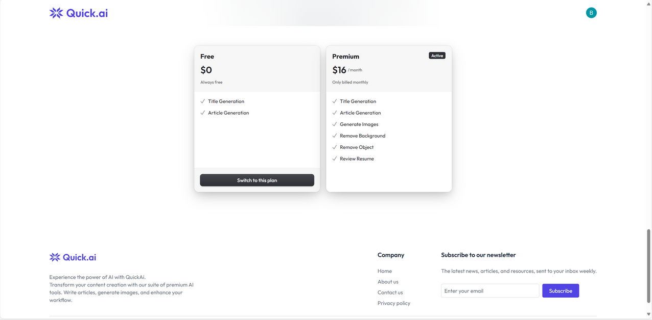

Slide 26
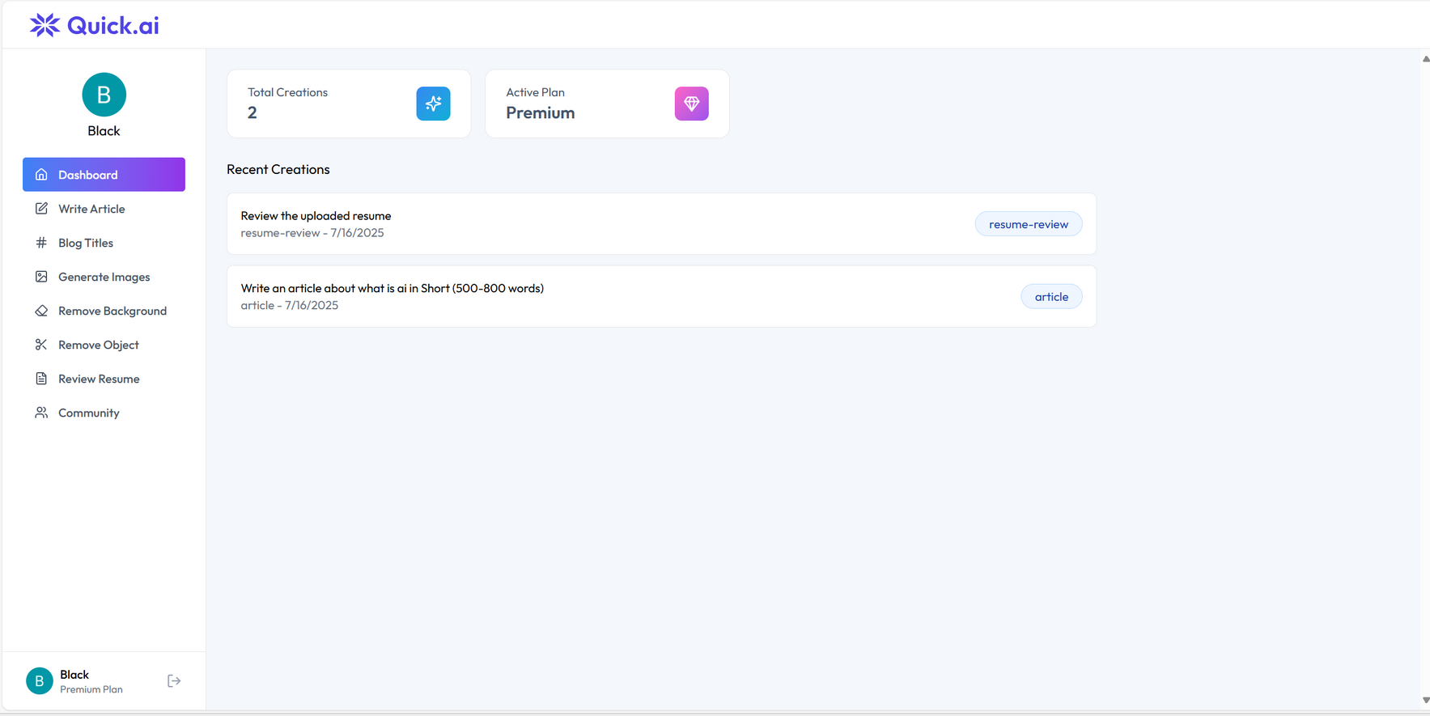

Slide 27
Wardiere Inc.
Home
Service
About Us
Contact
Search . . . .
THANK YOU

